Slide 1
Python REST implementation assignment of Organization Personnel Managing
Efim Zabarsky

Slide 2
Requirements
Functional
Add personnel
Remove personnel
Get all personnel
Get personnel by Birthday
System
Server side implemented in python, FLASK package
Server side uses JSON file as a DB
Client side implemented in python, REQUEST package

Slide 3

Architecture

Slide 4
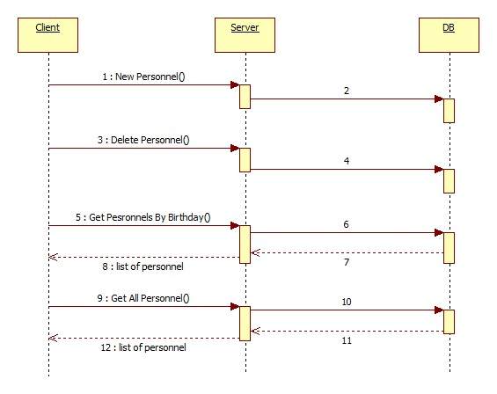
Organization Personnel Managing
Sequence Diagram
Notes:
4

Slide 5
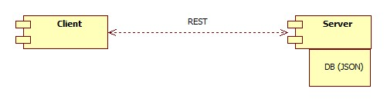
Organization Personnel Managing Component diagram
Notes:
5

